Slide 1
Tools for Training & Technical Assistance: Madcap Flare v. Adobe FrameMaker
Anna E. Holt
Tools & Technologies for Technical Writers (2025)

Slide 2
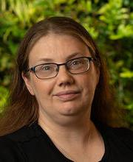
A Little About Me (Yes This is Relevant!)
Background -
Career: PreK-12 Research & Evaluation, Non-Profit & Social Services Consulting, Data Governance & Research Ethics
Personal: Neurodivergent & Trauma-Informed Care Speaking & Advocacy, Healthcare Patient Advocacy
Career Search Stats -
Targeting: Training & Technical Assistance/Curriculum Development, Technical Writing Primarily in Health, Biosciences/Cognitive Sciences
Grant Writing in Any Non-Profit or Social Services Sector
Some Application Stats (Since Fall 2024):
9 First-Round Interviews
5 (Maybe Soon 6?) Second-Round Interviews
2 Final-Round Interviews (Neither Ultimately Hired Someone)
1 Actual Job Offer (Unfortunately with the Federal Government)
2 Freelance Curriculum Development/Grant Writing Positions
And three things in common…

Slide 3
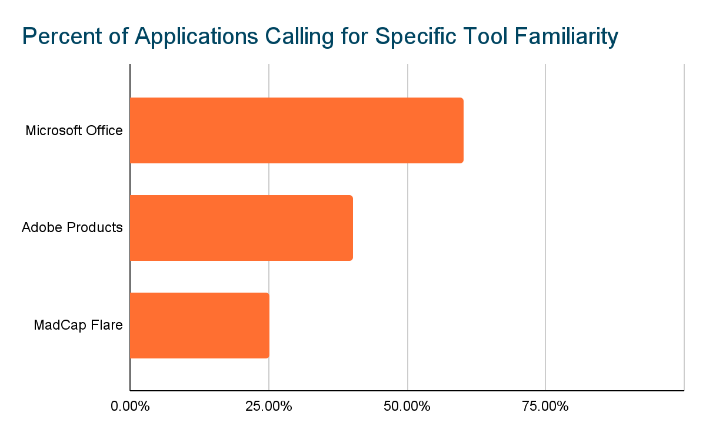
Most Referenced Tools Across All Contender Jobs
% of Recent Applicable Job Descriptions Referencing a Tool Covered in Class
Suspected Reasons for This Distribution
Most of these roles have involved working with frontline service staff, who may have less technology savvy than the software industry.
Many of these roles require formal sourcing and purchase orders for all tools, favoring established distributors with wide familiarity among users & established protocols.
These tool providers have made bulk licenses available to nonprofits, K-12, or government purchasers in the past.

Slide 4
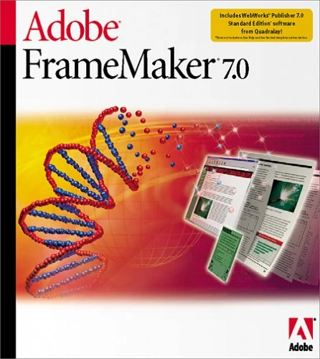


Picking a Favorite (That Has Better Version Control)
Adobe Products
InDesign
Illustrator
Framemaker!
Madcap Flare

Slide 5
Advantages of Alternatives to MS Office (For Me!)
Reusable content
Can read legacy content from other authoring tools (especially Word & Salesforce!)
Better version control (including a single-source master user)
Isn’t propriety about output formatting (including well-formatted pdfs)
Better for blogs and web content
Also integrates directly with major project management suites (e.g. Jira)
Looks good on a train (adapted for mobile and tablet usage)
Reusable content
More robust graphics support (and I am terrible at picture formatting in html-like products)
Built-in screen-reader support that has more help available (since I target disabilities and neurodiverse audiences)
Runs fast with multiple documents open & very large files (which often happens with detailed pictures or custom diagrams)
My fields are as dated as Framemaker
My fields still put out printed conference materials and other “book formats”

Slide 6
Disadvantages of Alternatives to MS Office (For Me!)
Not available on mac!
Not available on mac!
Very expensive for a single license even for one tech writer ($2k) & in the current administration not a write-off
Currently, does not directly integrate with Adobe products or Canva
Software updating is frequent and may disrupt workflows (already have had to fully update it once just between initial install for homework and this project to the 2025 version)
The reddit suggests that “those who know” Madcap Flare vs. “think they know” can really mismanage a product. Steep learning curve!
Unintuitive error feedback & need to code to error fix
While the Adobe Creative Cloud suite is comparatively affordable (as low as $13.99 per product, or $399/year for my target orgs), Framemaker itself is not included!
Can be less well integrated with non-Adobe or Word products. IT is part of project management and Tr./Tech Asst. Leaving them behind exacerbates the “silo effects” of education fields historically
While my fields are slow to adopt tech, FrameMaker itself is weaker on xml
Harder to send out ‘review copies’ for comments

Slide 7
So Why Pick Madcap Flare?

Slide 8
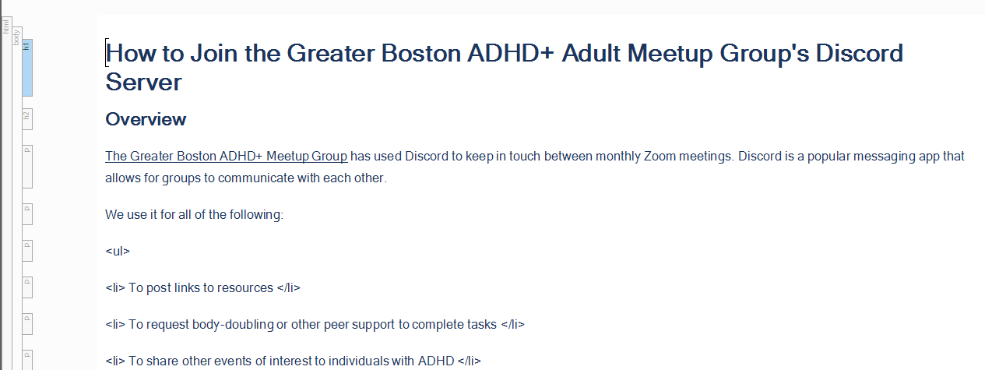
I don’t think fluently in HTML yet, but I like to know it’s there!

Slide 9
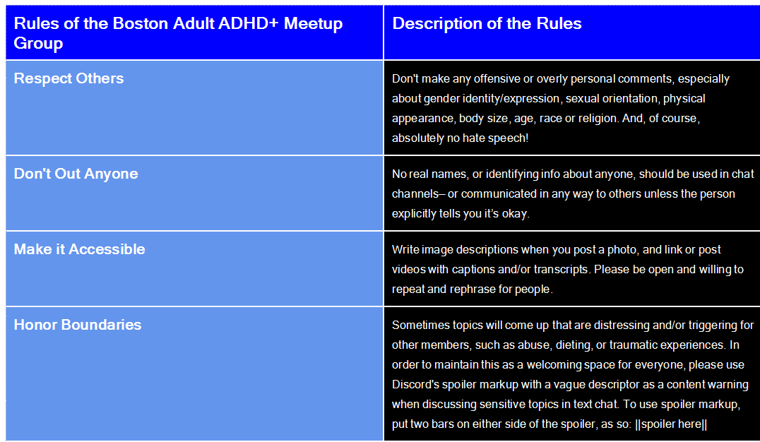
Editing tables feels less clunky and more like Excel or stats software

Slide 10
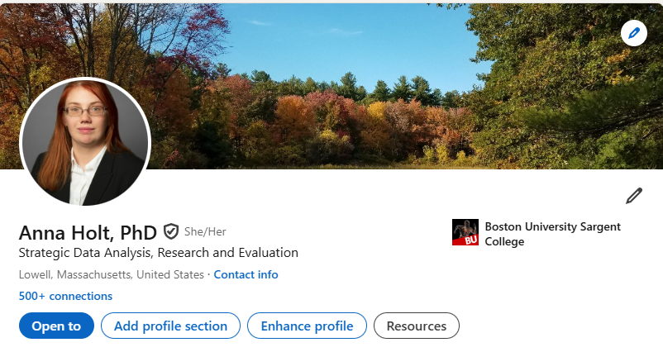

I’m looking for something beyond Wordpress to stand out from the job search crowd

Slide 11
Thank you, Zoë and Chuck!: Best wishes everyone for future career success
My email to keep in touch: aemholt@gmail.com

